Slide 1

third edition
THE INTERNET, DIGITAL MEDIA &
TECHNO-SOCIAL LIFE
MARY CHAYKO
10.Our Superconnected Future

Slide 2
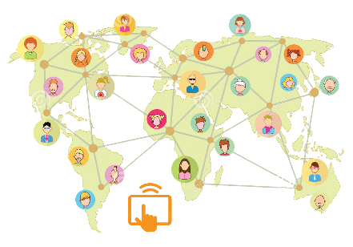

NEW AND EMERGING TECHNOLOGIES
Digitally enabled devices are now used in almost all aspects of everyday life.
New and emerging technologies and applications of technology are being developed at unprecedented rates.
It is impossible to know for certain how our superconnected future will look, but critical to try to understand it and make some educated predictions, for our society’s future is our future.
Image Source: Dreamstime.com

Slide 3
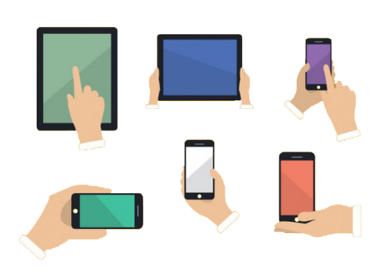
NEW AND EMERGING TECHNOLOGIES
Some of the most important technological developments on the horizon encompass digital structure itself.
The computing capacity of computer hardware, for example, has been doubling every 18 to 24 months, and this is projected to continue in the future. Known as Moore’s law, this means that in 15 years, computing capacity will have increased 1,000 times.
Meanwhile, as computing becomes smaller and more powerful, the internet and mobile media can be increasingly accessed on smaller and more powerful devices, and graphical displays are becoming increasingly interactive, detailed, and graphically dense.
Image Source: Freepik

Slide 4
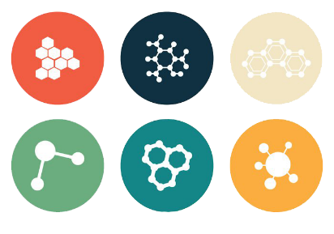
NEW AND EMERGING TECHNOLOGIES
The miniaturization of computer technology has resulted in the development of computer chips that are now so tiny that they are called nanochips. These chips can now be implanted in the body, raising serious questions about external access to the most private personal information, as well as human dignity and individuality.
Image Source: Vecteezy

Slide 5
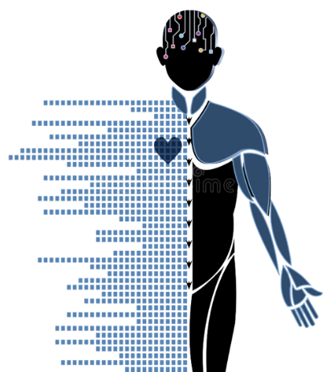
NEW AND EMERGING TECHNOLOGIES
In Europe, human-looking “social companion” robots are being developed to offer people reminders about appointments and medications and to encourage social activity, healthy eating, and exercise. Researchers in the United States have developed robots to assist in surgery, deliver medications and other supplies in hospitals, and assist with rehabilitation efforts.
Image Source: Dreamstime.com

Slide 6

THE TECHNO-SOCIAL PATH AHEAD
Perhaps the most likely predictions that could be made regarding tech societies of the future involve ever-increasing surveillance. More kinds of information are likely to be unearthed by more companies in an attempt to profile individuals and groups more and more specifically. It will become even harder to keep aspects of one’s life private or obscured.
Image Source: svri.org

Slide 7

THE TECHNO-SOCIAL PATH AHEAD
More predictions by the author:
Data mining and gathering will become more stealthy and pervasive.
Public environments will become laden with sensors that collect information as we move through them.
Implantable chips will become more widespread and promoted on the basis of their “convenience.”
It may become difficult if not impossible to escape being monitored nearly all of the time. Almost as concerning is the fact that we will not know when and whether we are being monitored.
Image Source: thenounproject.com

Slide 8
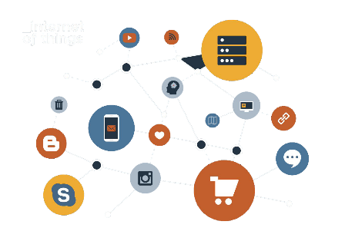
THE TECHNO-SOCIAL PATH AHEAD
More and more items that surround us daily are becoming digitally enabled and connected. Such items as TVs, kitchen and home appliances, toys, and cars can now be connected to the internet and to one another in large systems.
These systems can generate information, collect data, and provide feedback as to how they are being used. Information on the human beings in their surroundings can be gathered constantly and invisibly, making everyday objects tools for surveillance.
Image Source: tekmarsolutions.com

Slide 9
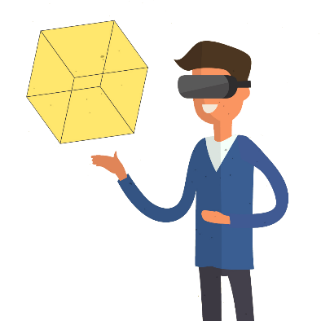
THE TECHNO-SOCIAL PATH AHEAD
Virtual and augmented reality applications in work, play and leisure have expanded our abilities to create true immersive environments.
Except in extreme cases, people do not seem to want or allow these environments to substitute for the face-to-face experience.
But what is the long-term impact of spending large amounts of time in them? And how will we, and our traditional institutions, change in response to them?
Image Source: Vexels

Slide 10
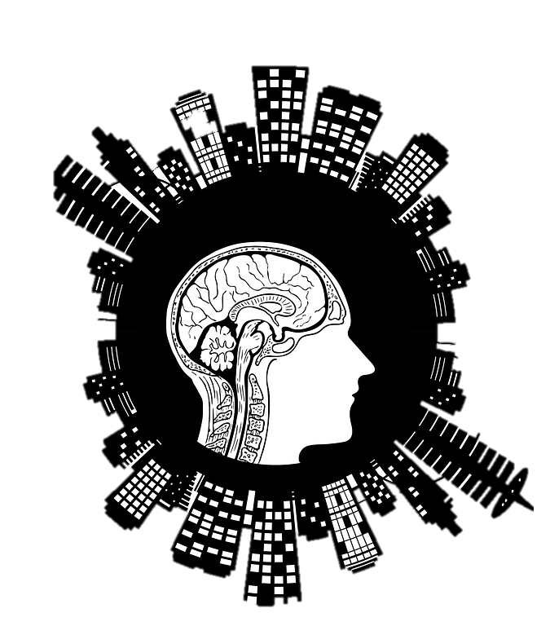
THE TECHNO-SOCIAL PATH AHEAD
Entire cities now can become technologized or smart–“smart cities”.
Technologies that sense people’s behaviors and even atmospheric conditions like the weather can be combined with data mining and surveillance tools integrated with the city’s infrastructure.
Image Source: Needpix.com

Slide 11
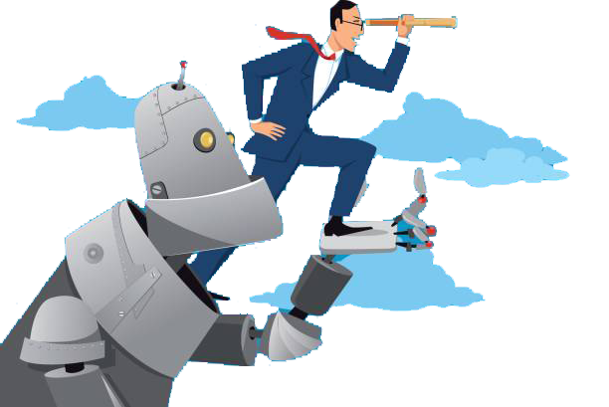
THE HUMAN-MACHINE CONNECTION
Humans and machines will continue to come into contact in personable, humanlike ways that resemble (but are not the same as) human-to-human relationships.
It is already impossible to tell for certain whether a video or photo is technologically altered or not, and the same will be true for mediated interactions, which can easily have an element of augmented reality. We are already influenced by, and possibly communicating with bots online.
Image Source: iStock

Slide 12
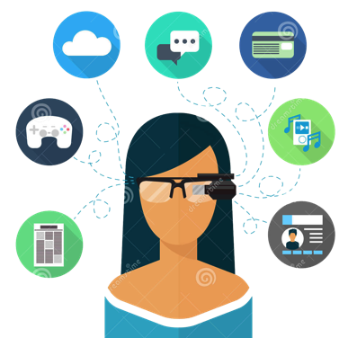
OUR PERSONAL PATHS
There are many more questions than answers surrounding the future of the internet, digital media, and technology in our rapidly changing society.
As we have seen, uncertainty as to how technology can affect norms, practices, the world around us, and our very selves can lead some to blame the tools themselves, calling on technological determinism to explain the changes they see around them.
Change is constantly underway in tech-rich societies, and it is not always easy to handle.
Image Source: Dreamstime.com

Slide 13

OUR PERSONAL PATHS
But change is the only certainty as we move along our personal and social pathways.
Individuals will always be challenged to create cohesive identifies and communities and to understand the workings of both.

Slide 14

OUR PERSONAL PATHS
Still, we can remind ourselves that continuity is at least as prevalent as change.
Old and new media often coexist side-by-side (pencils and computers, books and e-readers, pianos and electronic synthesizers).
The world does not completely re-make itself overnight (although it sometimes feels that way)!
Image source: henrygilamonster.wikispaces.com

Slide 15

OUR PERSONAL PATHS
Individuals will continue to express and expand their humanity – to explore new uses and implications of the internet and digital media and to consider how to fold these new practices into their current livelihoods and lifestyles.
Image Source: Freepik

Slide 16
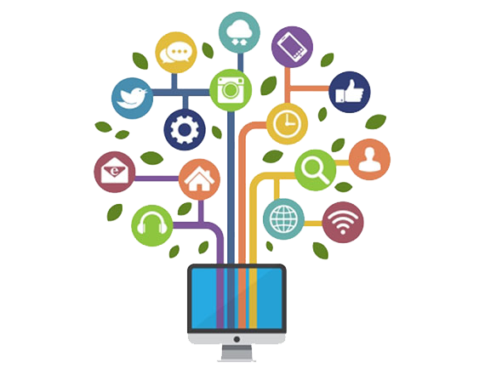
OUR PERSONAL PATHS
The future holds infinite possibilities. These can be daunting and overpowering or exciting and freeing.
We must make choices that empower us, help others do the same, and work to keep our techno-social institutions strong, so that we can build a superconnected, techno-social world worth living in.
Good luck on your superconnected journey!
Image Source: nebulastree.com

Slide 17


THE INTERNET, DIGITAL MEDIA & TECHNO-SOCIAL LIFE, 3RD EDITION
MARY CHAYKO
These lecture slides support the Sage Publications book Superconnected: The Internet, Digital Media, and Techno-Social Life (third edition, 2021) by Mary Chayko (Rutgers University) and were created by Mary Chayko, Shravan Regret Iyer and Seulki Lee-Geiller.
Text is excerpted from, and sources are referenced in, the book. Permission to use and share this slideshow is granted; please acknowledge Mary Chayko as author. For permissions and options for customizing these slides, contact Prof. Chayko at mary.chayko@rutgers.edu.
Review copies of Superconnected and copies for purchase may be obtained here

