Slide 1

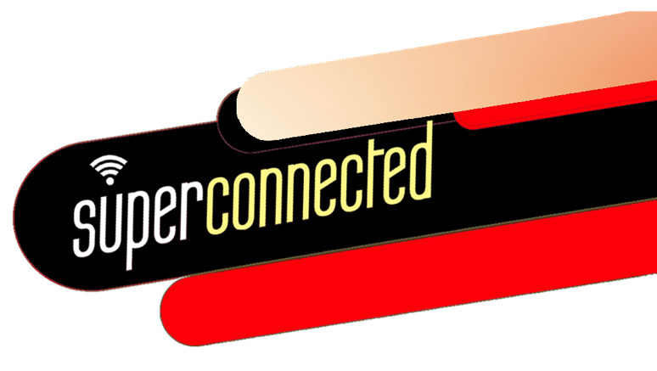

third edition
THE INTERNET, DIGITAL MEDIA &
TECHNO-SOCIAL LIFE
MARY CHAYKO
1. SUPERCONNECTEDNESS

Slide 2
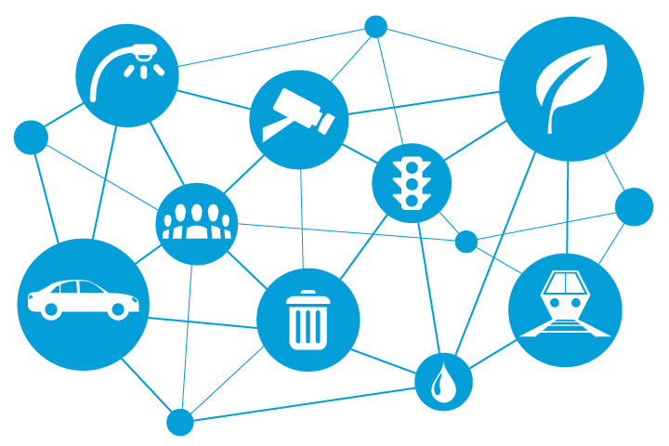

SUPERCONNECTEDNESS
Our societies are superconnected, and so are we—never in human history have so many been connected to so many others, in so many ways, with such wide-ranging social implications.
This book explores these implications with respect to a wide range of topics from a variety of perspectives and disciplines.
Image Source: www.cisco.com

Slide 3
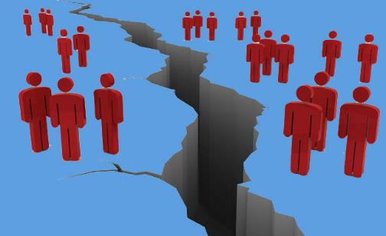
BUT COMPUTER-ENABLED CONNECTEDNESS HAS ITS LIMITS…
There are places in the world, including much of southern Asia and sub-Saharan Africa, in which internet access, computers, and even electricity are seriously scarce.
Although cell phones have penetrated the developing world to a much greater extent than computers have, they are used in fairly limited ways, and users are hindered by inconsistent internet access, unreliable service, and difficulty charging their phones.
Image Source: magic.piktochart.com

Slide 4

SOCIAL FACTORS THAT IMPACT INTERNET CONNECTEDNESS
Socioeconomic
status
Educational Background
Race
and more…
Ethnicity
Gender

Slide 5

MODERN LIFE, INTERNET AND DIGITAL MEDIA
Internet and digital media have become embedded in nearly every facet of modern life, including cities, cars, home appliances, lighting and heating products, and health and lifestyle monitoring.
This is sometimes called the “Internet of Things” or the “Outernet.” A traditional computer is not always required!
Image Source: www.dreamstime.com

Slide 6

THE INTERNET…
The internet is a global network of circuits, tubes, and packets of data that connect countless billions of computerized devices and, thus, the people that use these devices.
The web is a system of hyperlinked pages and documents that exists on the internet.
Though often spoken of interchangeably, the internet and the web are not the same thing!
Image Source: seeklogo.com

Slide 7

…FACILITATES SUPERCONNECTEDNESS
Using internet services, people find one another, learn about one another, exchange information and social support, work, play, and become connected, so copiously and completely that we can say they become superconnected.
Some use the term “hyper-connected.” The author (Prof. Mary Chayko) prefers the term “superconnected,” as the prefix “hyper” can imply that the connectedness generated in internet and digital media use is extreme and problematic – which it may or not be.
Image Source: freepik.com

Slide 8

COMPUTERIZATION & COMPUTER-MEDIATED COMMUNICATION (CMC)
Computerization is required for these operations to work and for smaller networks to detect one another and become interlinked.
Many types and sizes of computers work through many types of devices. Cell phones and smartphones are really best thought of as tiny computers that enable digitized, portable, near-constant communication via numerous platforms (i.e. Facebook, Instagram)
Image Source: conceptdraw.com

Slide 9

CELLULAR AND SATELLITE NETWORKS IN COMMUNICATION
Some communications exchanged on mobile devices, such as texting, gaming, and instant messaging via SMS, are facilitated by cellular and satellite networks rather than the actual internet. That is, these networks may not technically be part of the internet.
But as they are digitized and serve to connect people, they contribute in a major way to techno-social life, and are therefore be examined in this book alongside internet and digital/social media applications.
Image Source: conceptdraw.com

Slide 10
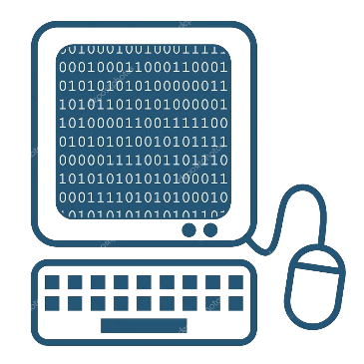
DIGITAL MEDIA…
Media are considered to be digital when data are communicated via computerized networks in bursts of invisible energy (bits).
As information is digitized, countless bits of data are represented and stored by computers as digits—zeroes (representing “off”) and ones (representing “on”)”
Image Source: static3.depositphotos.com

Slide 11
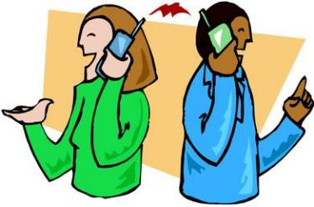
…ALSO FACILITATES SUPERCONNECTEDNESS
As technology advances to create more and more ways for people to become connected and to impact the world around them, a full complement of technologically enabled activities has transformed everyday life.
Even people who do not personally go online much (or ever) or who do not use social media have had their lives changed dramatically by the global internet, digital media, and mobile media revolution.
Image Source: Livingwithtech.wikispaces.com

Slide 12
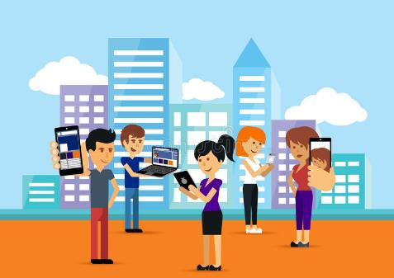
TECHNOLOGY
A technology is the process or technique of making something that allows human beings to share their knowledge, perform a task, or fulfill a function. It can also be thought of as a tool or invention that, once created and used, is intended to solve a problem or improve on past understandings of how to do something.
Technologies are not necessarily digital or electronic. A pencil and paper can be considered technologies.
Image Source: dreamstime.com

Slide 13

TECHNOLOGICAL DETERMINISM
This is the tendency to “blame the technology” itself when something goes wrong when it is used.
People design and create technology and people use it (though not in a vacuum – there are always issues of power to be taken into account).
It is not useful or accurate to think of technology as an entity doing something to people and then to blame the technology when things go wrong or get complicated.
It is useful, though, to ask who benefits from a technology and who is left behind or left out when it is used.
Image Source: Pixabay

Slide 14

SOCIAL CONSTRUCTIVISM
Technology reflects, and often advances, the interests of those who create it and fund it.
It is not neutral—it is not just a thing or a tool—but something that can disproportionally benefit those who make it, profit from it, or control its use.
To consider how the invention and use of technology is related to forces like political power, social class differences, and organizational dynamics is called the social constructivist approach to the study of technology.
Image Source: us.123rf.com

Slide 15
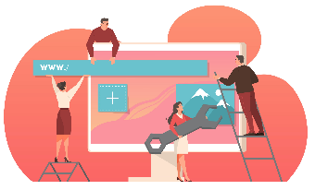
TECHNOLOGY IN SOCIAL SYSTEMS
Technologies are designed, invented, built, and disseminated by people who continually shaped them. This interdependent set of actions is called the sociotechnical systems approach. ​
​
This perspective is closely related to the concept of sociomateriality, which states that substantive features of a product and social behaviors co-construct each other. ​
​
As human biases (i.e., race, ethnicity, age, sexual orientation, socioeconomic status) are introduced to a system, reinforce and solidify one another, systemic bias occurs.​
​
Those of us who study the impact of technology on societies, groups, and individuals must remain aware of these social forces and biases.​
Image Source: stock.adobe.com

Slide 16
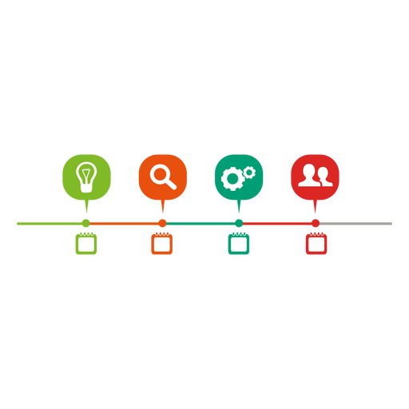
TECHNOLOGICAL MEDIATION
Information and Communication Technologies (ICTs) carry ideas and information from one person to another.
When this process occurs, it is called mediation or technological mediation, and the technology itself can be considered a mediator.
Image Source: Vexels

Slide 17
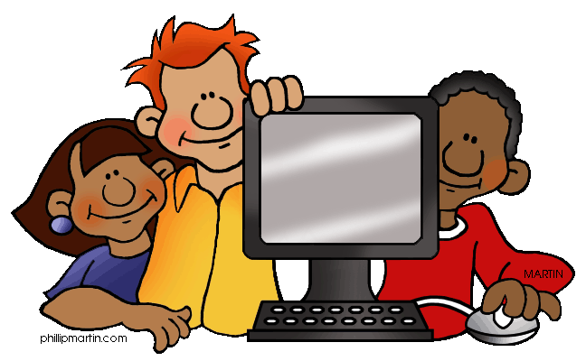
SOCIALITY AND TECHNO-SOCIAL LIFE
People’s tendency to form connections and bonds with one another, and to live life in concert with others, is called sociality.
It is not necessary to be physically face-to-face with another person for sociality to develop.
Our lives are highly social and strongly influenced by technology. They are techno-social, with both parts of the word (“techno” and “social”) equally important. It is critical to study technology and society in concert with one another – one of the central concepts of Superconnected.
Image Source: williamstechlab.wikispaces.com

Slide 18

THE INTERNET, DIGITAL MEDIA & TECHNO-SOCIAL LIFE, 3RD EDITION
MARY CHAYKO
These lecture slides support the Sage Publications book Superconnected: The Internet, Digital Media, and Techno-Social Life (third edition, 2021) by Mary Chayko (Rutgers University) and were created by Mary Chayko, Shravan Regret Iyer and Seulki Lee-Geiller.
Text is excerpted from, and sources are referenced in, the book. Permission to use and share this slideshow is granted; please acknowledge Mary Chayko as author. For permissions and options for customizing these slides, contact Prof. Chayko at mary.chayko@rutgers.edu.
Review copies of Superconnected and copies for purchase may be obtained here

