Slide 1

third edition
THE INTERNET, DIGITAL MEDIA &
TECHNO-SOCIAL LIFE
MARY CHAYKO
2. CREATING THE INTERNET AGE

Slide 2


SHORT HISTORY OF INFORMATION AND COMMUNICATION TECHNOLOGY
Communication is prehistoric, preliterate, preverbal, and even nonverbal—think of how much is communicated by body language.
Prior to the invention of words and writing, people sent messages to one another using gestures, grunts, cries, and crude symbols like cave paintings, stone carvings, and smoke signals.
Image Source: colourbox.com

Slide 3
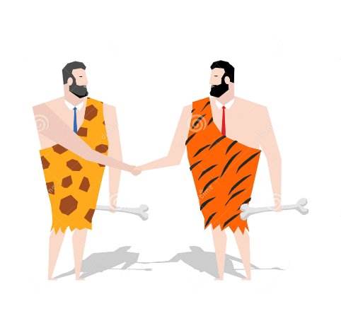
SHORT HISTORY OF INFORMATION AND COMMUNICATION TECHNOLOGY
Slowly, communication became verbal and more complex; grunts became words and words became spoken languages.
Formal languages began to coalesce and spread, probably between 150,000 and 350,000 years ago, though it could have been even earlier—it is extremely difficult to pinpoint with accuracy things that happened before written records were kept.
Image Source: dreamstime.com

Slide 4

SHORT HISTORY OF INFORMATION AND COMMUNICATION TECHNOLOGY
In or around 1450, Johannes Gutenberg introduced a mechanical movable type machine called a printing press and ushered in the era of mass production and communication. Books, including the Bible, could now be mass-produced—indeed, they could become bestsellers.
The technology quickly caught on; within fifty years, tens of millions of copies of books had been printed. Pamphlets, newspapers, and magazines soon became set in movable type as well.
Image Source: Noun Project

Slide 5
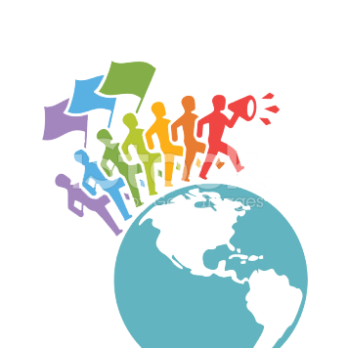
SHORT HISTORY OF INFORMATION AND COMMUNICATION TECHNOLOGY
The mass-media era was now swiftly underway, ushering in a time of rapid social change, as political movements (like the American Revolution), social movements (civil, labor, and women’s rights), and the beginnings of public education all gathered large-scale strength with the ability to disseminate ideas and information widely.
Image Source: comparativeprc

Slide 6
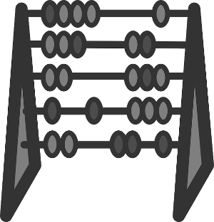
SHORT HISTORY OF COMPUTING AND THE INTERNET
The forerunners of modern computers actually date back thousands of years, when people began to develop nonmechanized (and later mechanized) means to count and calculate sums, document and catalog information, and automate certain of the functions of living.
Image Source: Pixabay

Slide 7
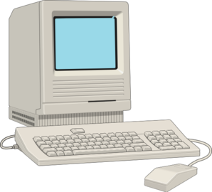
SHORT HISTORY OF COMPUTING AND THE INTERNET
In the 1950s, a number of computer scientists, psychologists, physicists, and other scholars began to imagine and develop interactive computers of the type that the internet would use.
Some, led by computer scientist John McCarthy, concentrated on the development of artificial intelligence, or computing systems able to perform tasks that would otherwise require human intelligence, such as visual perception, speech recognition, and decision making.
Image Source: Clker

Slide 8
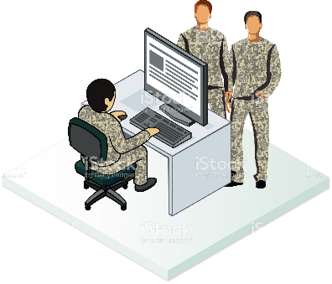
SHORT HISTORY OF COMPUTING AND THE INTERNET
What we now think of as the internet actually began as an initiative of a Department of Defense agency responsible for the development of technology for military use. It is called the Defense Advanced Research Project Agency, or DARPA.
Image Source: istockphoto.com

Slide 9

SHORT HISTORY OF COMPUTING AND THE INTERNET
ARPANET evolved into what we know as the internet, as research continued not only into the means of connecting and networking dispersed computers but into the possible uses of such a network.
Interested researchers, business professionals, and government and military users began utilizing these computers to share information with one another. The internet as we know it today was taking shape.
As recently as 1990, though, there were probably fewer than 5 million users worldwide.
Image Source: Creative Market

Slide 10

THE WEB IS BORN
In the 1989-1991, Tim Berners-Lee and colleagues develop the WorldWideWeb (originally all one word) and then make the technology available to the world at no cost to any particular organization.
This key moment in internet history meant that unfettered access to it would be the web’s most striking and enticing feature.
Aided by the internet’s open architecture, this would herald the web’s global (though not universal) spread and influence.
Image Source: Freepik

Slide 11

THE WEB IS BORN
Search engines, which provided a means for people to find what they were looking for on the web, soon followed, but they were not immediately seen as critical tools. Google, developed by Stanford Ph.D. students Larry Page and Sergey Brin in the mid 1990s, became available to the public in late 1997 and took web searching to the next level.

Slide 12
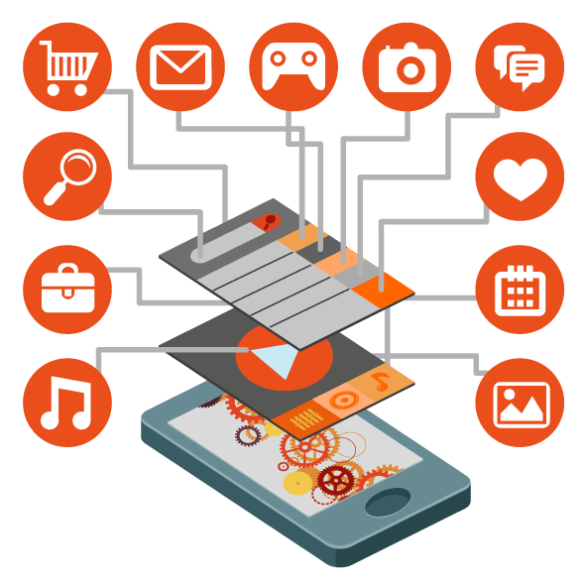
THE WEB IS BORN
Increasingly interactive software, media platforms, and specialized programs called applications or apps soon became much in demand. People with special interests from a wide range of backgrounds began to create the intricate and sophisticated web pages, sites, and blogs that now populate so much of the web.
Image Source: executivemarketingservicesllc.com

Slide 13
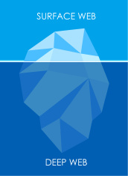
A DEEP, “DARK” WEB IS ALSO BORN
Sometimes called the “darknets,” these secretive sites increased in number throughout the 1980s and exponentially today.
The early 2000s saw the release of Freenet, software that facilitated passage to untraceable websites and areas of the internet, and HavenCo, a means for hosting restricted data.
Image Source: PicQuery

Slide 14


A DEEP, “DARK” WEB IS ALSO BORN
Requiring special encryption to be created, illegal activity often occurred on these sites, such as file-sharing of copyrighted materials, illegal gambling, and the exchange and use of illegal pornography, including child pornography.
As the website would not appear on search engines, someone who wanted to visit it would need to know the URL and type it in manually, which seemed to offer some level of identity protection and anonymity.
Image Source: Noun Project & games-answers.info

Slide 15

WIRELESS & MOBILE COMMUNICATION
Wireless communication dates back to the late 1800s, when electromagnetic waves, which make wireless connecting possible, were discovered.
Later came radio and TV shows and global positioning systems (GPS), used to determine location in cars, boats, and aircraft.
As of the mid-20th century, cellular, satellite, and other wireless networks became the foundation for modern mobile telephony, computer connectivity, Wi-Fi, and wireless broadband internet.
Image Source: mobilemarketingwatch.com

Slide 16

EARLY ONLINE NETWORKING
Online social networking is often described as one of the most recent applications of the internet and the web, but it actually predates both.
The first computerized interpersonal social networks arrived in the mid-1970s. Someone would electronically post a message and someone else could respond. At first, this exchange had to be asynchronous—in fact, in these early days, it could take days or even weeks for a response to appear!
Image Source: freepik.com

Slide 17
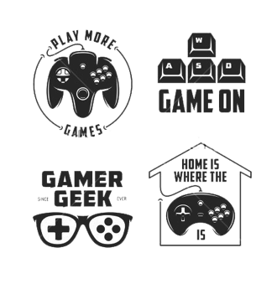
EARLY ONLINE NETWORKING
Online gaming was born and gained steady popularity in the 1970s as well. Some games were adventure based and encouraged their players to create what have been called virtual “worlds” together.
In these worlds, large numbers of users cocreate meaningful domains or environments in which they interact, play games, and form relationships, including romantic and cybersexual relationships.
Image Source: thumb9.shutterstock.com

Slide 18
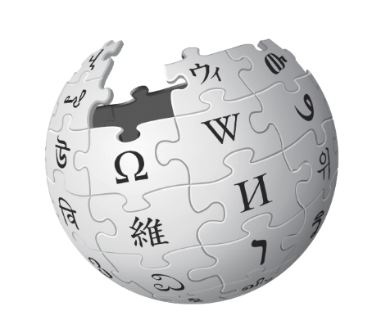
EARLY ONLINE NETWORKING
The birth of Wikipedia came in 2001, and wikis and collaborative practices, such as video, audio, and text conferencing, continued growing.
Wikipedia is an extensive expression of the gathering of large amounts of information in an easy-to-access place. It is similar to an encyclopedia (from which its name is partly derived), but it is continually updated by the millions of users (or “editors”) who contribute to it.
Image Source: cdn.arstechnica.net

Slide 19

FULL-FEATURED SOCIAL NETWORK SITES (SNSS) AND SOCIAL MEDIA
In the very late 1990s and early 2000s, a number of sites sprang up that were sufficiently different from earlier experiments that they began to be known by the specialized name social network sites (SNSs).
On SNSs, users could easily see and locate followers’ profiles, create their own profile pages, and communicate one-to-one or one-to-many equally well.
Image Source: Freeicons

Slide 20

FULL-FEATURED SOCIAL NETWORK SITES (SNS) AND SOCIAL MEDIA
Facebook has proven that social networking can be very big business. Social media specialists, designers, writers, and managers have joined computer scientists, information technology professionals, and other tech careerists in becoming a large and rapidly growing sector of the modern workforce.
The commercialization of Facebook with advertising and frictionless sharing have been criticized as eroding community, rather than building it, and harming democracy at the expense of monetization (i.e., false news, ads and fake accounts in the 2016 and 2020 US presidential elections). Is it (and other big tech companies like Google) too big, too unregulated, too powerful?
Image Source: Iskillyuva

Slide 21

THE TRIPLE REVOLUTION OF THE 2000s
The ever-increasing and interconnected prominence of (1) the internet, (2) mobile communication, and (3) social media networking has catalyzed what sociologist Barry Wellman and research specialist Lee Rainie call a “triple revolution” in social connectedness that has come about largely since 2000.
Societies at all levels of technological sophistication have been affected.
And more computer-related revolutions are clearly on the horizon…
Image Source: Pixabay

Slide 22


THE INTERNET, DIGITAL MEDIA & TECHNO-SOCIAL LIFE, 3RD EDITION
MARY CHAYKO
These lecture slides support the Sage Publications book Superconnected: The Internet, Digital Media, and Techno-Social Life (third edition, 2021) by Mary Chayko (Rutgers University) and were created by Mary Chayko, Shravan Regret Iyer and Seulki Lee-Geiller.
Text is excerpted from, and sources are referenced in, the book. Permission to use and share this slideshow is granted; please acknowledge Mary Chayko as author. For permissions and options for customizing these slides, contact Prof. Chayko at mary.chayko@rutgers.edu.
Review copies of Superconnected and copies for purchase may be obtained here

