Slide 1

third edition
THE INTERNET, DIGITAL MEDIA &
TECHNO-SOCIAL LIFE
MARY CHAYKO
3. INHABITING A DIGITAL ENVIRONMENT

Slide 2
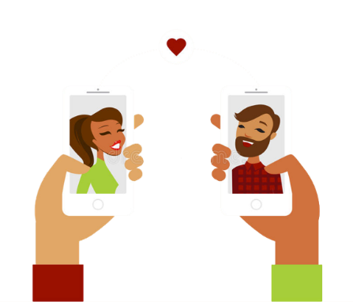

SOCIOMENTAL SPACES, CULTURES, AND SOCIETIES
When the environments in which we live and form relationships are digitized, they become potentially portable.
These spaces, and the activities, bonds, and connections formed within them, can also be described as sociomental because the connectedness is interpersonal (the social part) and relies on cognitive rather than physical activity for its creation and maintenance (the mental part).
Image Source: Dreamstime.com

Slide 3
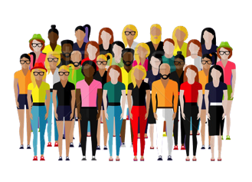
SOCIOMENTAL SPACES, CULTURES, AND SOCIETIES
A society is made up of the thoughts, ideas, information, norms, values, beliefs, and morals of all of its members.
It is a kind of “soup” of these mental ingredients, plus the material products created by its members, such as art, books, buildings, and clothing.
Collectively, we call these mental and material products the culture of a society.
Image Source: Stockfresh.com

Slide 4

SOCIOMENTAL SPACES, CULTURES, AND SOCIETIES
Digital experiences, and the spaces in which they take place, are totally real, with very real consequences.
Online classes can be taken for real course credit, real money is kept in online bank accounts, and real relationships and marriages have been destroyed by online infidelity.
Contrasting “digital life” with “real life,” therefore, doesn’t make sense. The digital is real!
Modern life, and reality itself, is simultaneously “techno” and “social” – it is techno-social.
Image Source: WPClipart.com

Slide 5
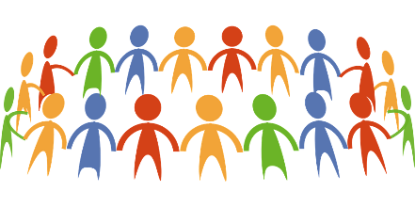
ONLINE COMMUNITIES, NETWORKS, AND NETWORKING
Communities are constituted of, and provide for their members, regular, patterned, personalized social interactions.
In them, people develop a shared identity, culture, purpose, and fate, and feelings of togetherness and belonging.
The internet and digital media readily inspire and facilitate the creation and establishment of communities.
Image Source: Pixabay.com

Slide 6

CREATING DIGITAL ENVIRONMENTS
Shared symbols, such as language, images, sounds, gestures, and avatars, help people envision, build digital environments.
Members of groups create and use symbols constantly:
sports teams and schools have slogans, logos, and representative colors
friends and families have favorite foods, nicknames, and catchphrases
religions and nations have to icons, statues, pictures, and documents
These symbols help define the group so everyone knows who is in it, and help shape the environment by creating a kind of invisible boundary around it. If you understand the symbols, you’re “in.” Otherwise, you’re “out.”
Image Source: Freedesignfile.com

Slide 7
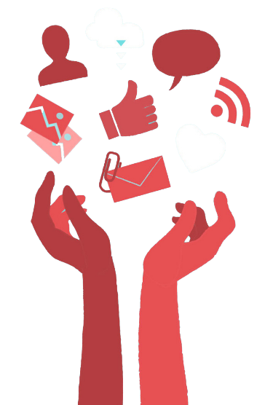
CREATING DIGITAL ENVIRONMENTS
A digital space called a platform is a computerized framework on which an application can run. Platforms can be blogging sites like Blogger and WordPress, social media sites like Facebook, Twitter, and Instagram, video-streaming sites like Netflix, Hulu, and YouTube, or audio sites like iTunes and Spotify.
Image Source: Vector4free.com

Slide 8
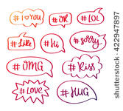
CREATING DIGITAL ENVIRONMENTS
Hashtags have real power to help people become grouped together in social media environments.
They facilitate the gathering of people in online spaces to talk about TV shows, current events, and take part in “Twitter chats.”
They are also used to emphasize, critique, rally people together, identify characteristics of the writer, and specify and spread internet memes.

Slide 9

BIAS AND STEREOTYPING
Prejudice, or attitudes about groups that do not take individual characteristics into account, can lead to discrimination: differential treatment including negative or harmful outcomes.
Stereotyping is very much in evidence on social media and via search engines. For example, SNSs provide many stereotypical images of women and girls as sexualized objects.
Occupations are also highly stereotyped: nurses and librarians continue to be disproportionately depicted as women, while computer civil engineers and computer programmers are disproportionately depicted as men. This can affect the career paths that people choose and, in an even more general sense, social justice and pay equity.
Image Source: stock.adobe.com

Slide 10
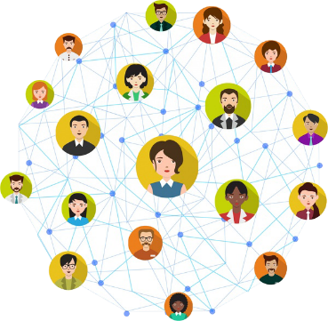
REALITY, PRESENCE, AND PROXIMITY
Because online social connections are so often experienced as absolutely real and deeply personal, we often perceive digitally encountered others to be present to us.
The internet and digital media facilitate the perception and experience of proximity and presence in ways that transcend the physical.
When connecting online, those with whom we connect are often perceived to be “really there.” This sense that the other is “really there” is called social presence.
Image Source: Allfreedownload

Slide 11
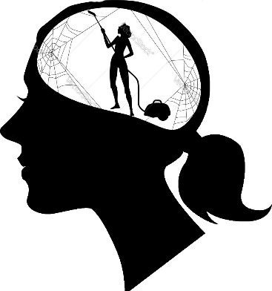
REALITY AND THE BRAIN
The mind and body are intricately connected.
They affect one another continuously, as can be seen in physical illness that derives from psychological disturbance, or in mental confusion that results from physical fatigue.
Our minds and bodies “talk to” and inform one another all the time. They are a unit, finely meshed
Image Source: Vectorstock

Slide 12
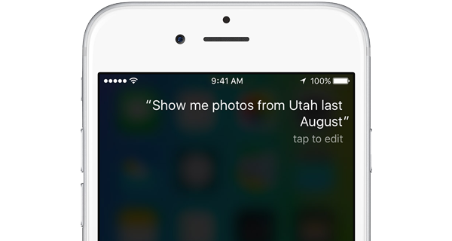
REALITY AND THE BRAIN
Robots and bots—humanlike machines and web-based software applications that run automated tasks—are becoming in some cases interactive and seemingly personable.
Such machines and applications can be comforting and help people cope with challenges and even provide some forms of social support, although there are limits to the types of communication that the artificial intelligence of computers can perceive. Siri, for example, cannot detect sarcasm.
You could be chatting with a bot online or reading a story written by a bot and never even know it.

Slide 13
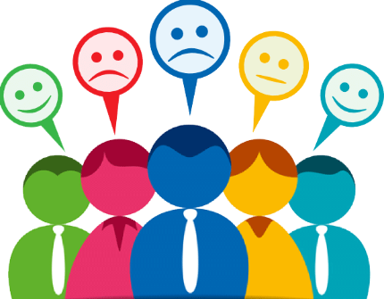
EMOTIONALITY AND INTIMACY
It is common for time spent online to have an intimate, emotionally rich dynamic.
Intimacies and emotions that arise in online interaction serve as a kind of “glue” for the relationships that form there.
This “emotional glue” is especially important in the absence of the “physical glue” that face-to-face interaction can provide.
Image Source: Alternatives

Slide 14
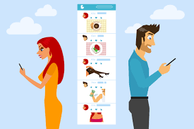
SO, WHAT ABOUT PHYSICALITY?
Some people find the physical body to be a distraction and that in its absence they are better able to form honest, authentic relationships.
For some, thoughts and feelings may be more easily, comfortably, and authentically shared when physicality is absent.
According to communication researcher and theorist Joseph Walther, when physical cues are filtered out, we use our other senses to adapt and process information accordingly. This is his “Social Information Processing” theory.
Walther has also theorized that in some cases, online interactions can even exceed physical interactions in terms of desirability and closeness. When this happens, he calls such relationships hyperpersonal.
Image Source: ahlooupdate

Slide 15

THE INTERSECTION OF THE ONLINE AND THE OFFLINE
It is tempting, and quite common, to assume that what we do online happens at the expense of or displaces the offline.
But most people utilize online connectedness to build, bolster, and give new dimension to face-to-face interactions and communities.
They choose their online friends from among their offline contacts and use both mediated and face-to-face means to sustain all their relationships.
Image Source: Calcative

Slide 16
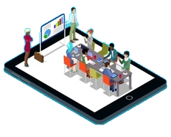
THE INTERSECTION OF THE ONLINE AND THE OFFLINE
One’s lived reality with technology is generally experienced as a blending, a mixture, of the online and the offline, rather than as one or the other.
We do not tend to separate our lives into online vs. offline, or digital vs. real. We experience these realms as a single, enmeshed, techno-social reality.
Image Source: VectorStock

Slide 17


THE INTERNET, DIGITAL MEDIA & TECHNO-SOCIAL LIFE, 3RD EDITION
MARY CHAYKO
These lecture slides support the Sage Publications book Superconnected: The Internet, Digital Media, and Techno-Social Life (third edition, 2021) by Mary Chayko (Rutgers University) and were created by Mary Chayko, Shravan Regret Iyer and Seulki Lee-Geiller.
Text is excerpted from, and sources are referenced in, the book. Permission to use and share this slideshow is granted; please acknowledge Mary Chayko as author. For permissions and options for customizing these slides, contact Prof. Chayko at mary.chayko@rutgers.edu.
Review copies of Superconnected and copies for purchase may be obtained here

