Slide 1

third edition
THE INTERNET, DIGITAL MEDIA &
TECHNO-SOCIAL LIFE
MARY CHAYKO
5. GLOBAL IMPACTS AND INEQUALITIES

Slide 2


GLOBALIZATION AND TECHNOLOGY
The world can, in many ways, be seen as a single, interconnected society. This is called globalization, and it has been made possible by innovations in transportation technology (such as highways, cars, railways, and air travel) and information and communication technology (such as the internet and digital, social, and mobile media).
Image Source:Allfreedownload

Slide 3
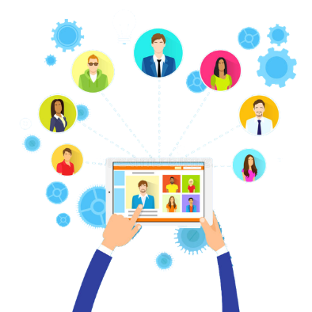
GLOBALIZATION AND TECHNOLOGY
As a result, a global marketplace for products like energy, cars, electronics, and entertainment has developed.
Sometimes this results in the outsourcing of jobs and opportunities, in which a job or job type that originated in one country becomes relocated to another, where it can likely be performed more cheaply.
Image Source:Dreamstime

Slide 4
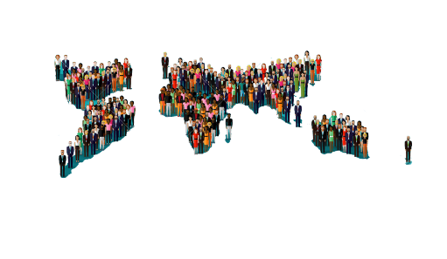
STRATIFICATION AND INEQUALITY
Groups and social units can be differentiated from one another in many ways.
People, and the groups and units to which they can be said to belong, can vary on a number of characteristics—age, race, ethnicity (people who share a common heritage or ancestry), gender, sexual orientation, socioeconomic status, intellectual or physical ability, occupation or occupational type, religious beliefs, political or national affiliation, and so on.
Image Source: 123rf.com

Slide 5
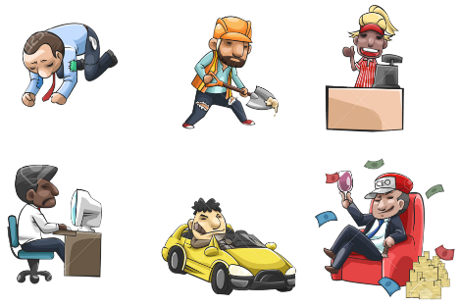
STRATIFICATION AND INEQUALITY
Societies are often metaphorically divided into layers or tiers (upper class, middle class, working class, the poor) that tend to be perceived as forming a hierarchy.
The process by which these layers are collectively determined and these divisions (and subdivisions) collectively form is called social stratification, and the societies are said to be stratified (another metaphor, derived from the layers found inside a rock or a tree, which are called strata).
Technology use and access often impacts one’s “placement” in one of these strata because tech skills and literacy are so important in the modern digital era.
Image Source: 123rf.com

Slide 6
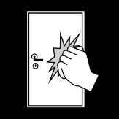
STRATIFICATION AND INEQUALITY
Low income and standard of living is a barrier to digital connectedness worldwide.
In poorer areas, even if internet access were available, it would be difficult for people to afford. The devices and hardware needed to become connected would also be relatively expensive.
When there is high unemployment and underemployment and people do not make enough money to cover basic necessities, they are essentially “locked out” from using the internet and from participating in a global economy predicated on technology.
Image Source: edupics.com

Slide 7

STRATIFICATION AND INEQUALITY
Lack of education is another barrier to internet and digital access.
People with limited or no relevant education may not have the skills required to use digital technologies, especially in ways that transcend the rudimentary.
For many, low levels of language literacy—difficulties in reading and writing—is a factor as well.
Image Source: Freepik

Slide 8
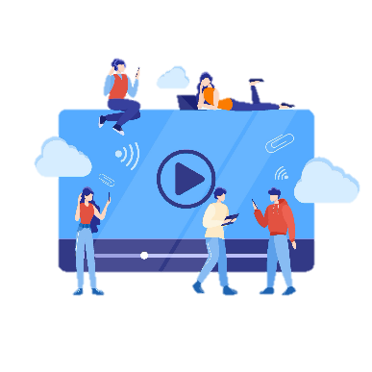
CULTURAL DIVIDES
The internet and digital media can contribute to the development of common understandings by providing a window on a variety of points of view.
However, we often see the opposite occur: people refusing to see or believe opposing points of view, aided by algorithms which provide only selected information to their feeds.
It is common for people to focus their attention on issues with which they are already familiar and communicate with those who feel the same way they do. All of this deepens cultural divisions and inequalities and furthers the spread of disinformation, falsehoods, and lies.
Image Source: stock.adobe.com

Slide 9
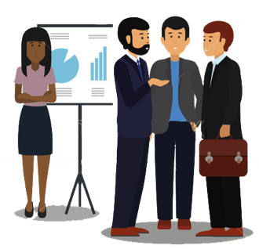
CULTURAL DIVIDES
Because the internet and digital media bring people into frequent contact with one another, prejudice and discrimination occur online just as they do face-to-face. People are not accountable to one another face-to-face, and we see negative, prejudicial and discriminatory behaviors very much in evidence in digital spaces.
When women and racial and sexual minorities are harassed and abused it is generally because they are members of these categories.
Harassment serves as an exertion of power to assert dominance, frighten, and punish those who have been historically disempowered—to keep them “in their place.”
Image Source: Shutterstock

Slide 10
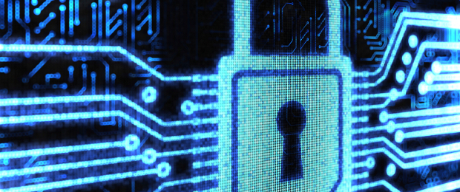
HACKING, DANGER, CRIME, AND WAR
Nations, organizations, and all kinds of entities have digital as well as physical borders—systems intended to provide technological access to those who belong to the group and to exclude those who do not.
Hacking is the manipulation of the programming codes that tell computers exactly what to do and is also often the term used to describe the manipulation or inappropriate release of the information that is obtained in this way.
Hacking can be done both legally and illegally, and for positive and negative purposes.
Image Source:blogthinkbig.com

Slide 11
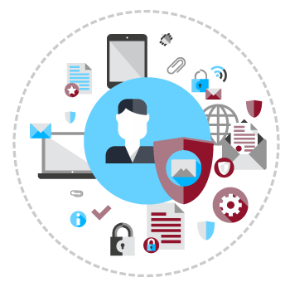
HACKING, DANGER, CRIME, AND WAR
Large-scale cyberattacks can take two forms: information attacks and infrastructure attacks.
In the former, personal information can be retrieved, made public, and used to harm or embarrass or generate fear.
In the latter, critical services can be disabled. Messages can be sent out under the ISP name of another organization, websites can be defaced, money and information can be stolen, sabotage can take place, threats can be made.
Image Source: luminantsecurity.com

Slide 12
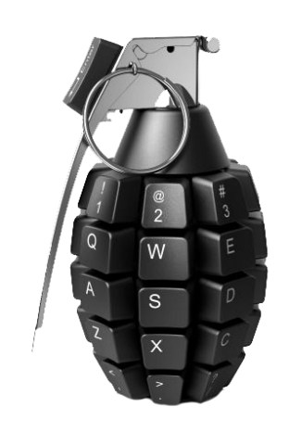
HACKING, DANGER, CRIME, AND WAR
Cyberwarfare can include attacks on populations, such as the sabotage of water systems, health communications, transportation, the electric power grid, military systems, financial networks, and the stock market.
Terrorist operations and hate groups now routinely coordinate their efforts via the internet, digital media, and mobile phones, even using mobile phones to detonate bombs.
Image Source: foreignaffairs.com

Slide 13
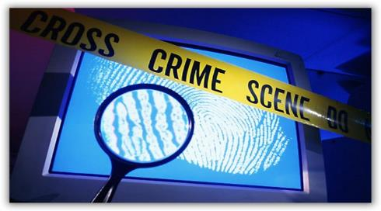
HACKING, DANGER, CRIME, AND WAR
Other digital crimes against individuals include identity fraud, theft, internet scams and spam, drug trafficking, exposing children to pornographic images, sexual predation, and kidnapping.
Image Source: readers-bench.com

Slide 14
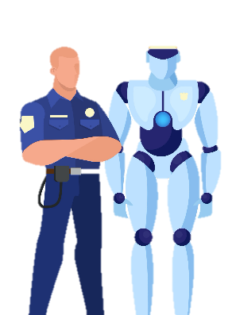
DIGITAL PUBLIC POLICY AND LAW
Most laws and policies that had their origins in a pre-digital era do not address digital or other modern crimes and issues satisfactorily. Without updated language of laws or policies to address the digital technologies, prosecutable action would be limited to crimes committed face-to-face or on older devices, failing to cover crime committed on newer devices.
On the other hand, considering how accessible and open computer systems should be is a crucial set of decisions that indicate much about what a society and a nation values.
Image Source: stock.adobe.com

Slide 15
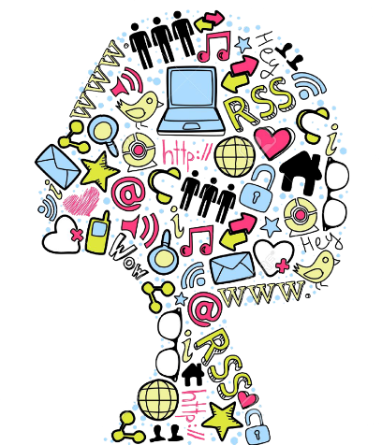
FINDING SOLUTIONS, BRIDGING DIVIDES
Social problems always resist easy solutions. They generally result from a complex tangle of factors that contribute to their development and complexity and complicate their resolution.
Given their widespread use and international scope, internet and digital technologies are integrated and implicated in all global and societal problems, such as poverty, crime, war, violence, destruction, racism, sexism, ageism, ableism, homophobia, and transphobia.
Image Source: 123rf.com

Slide 16
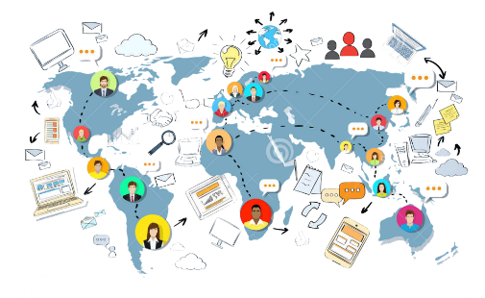
FINDING SOLUTIONS, BRIDGING DIVIDES
To bridge divides successfully and empower the world’s citizens, technological growth and development must be inclusive.
Three key components of inclusive growth are education, jobs, and well-being.
Digital technology can be an enabler, a catalyst, and a propelling force for all three.
Image Source: 123rf.com

Slide 17
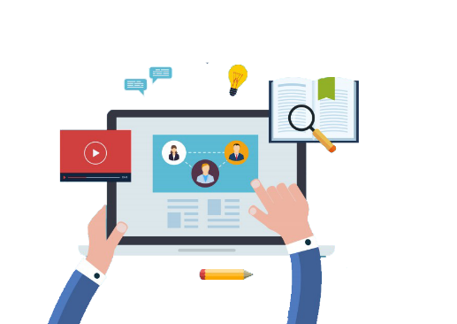
SOCIAL ORGANIZATION, MOVEMENTS, AND ACTIVISM
It is now possible to speak directly to politicians, business owners, or leaders of all kinds of organizations via a Twitter account or a blog, for example.
Social networks open up pathways by which messages can more easily be sent to those who are in power.
Image Source:Govloop

Slide 18
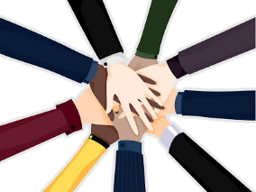
SOCIAL ORGANIZATION, MOVEMENTS, AND ACTIVISM
The internet and digital media also enable people to reach out to one another and organize their actions so that as a group they might make a greater difference.
Examples include the #BlackLivesMatter and #MeToo social movements, for which social media and hashtag use have been indispensable.
Image Source: Causeglobal

Slide 19
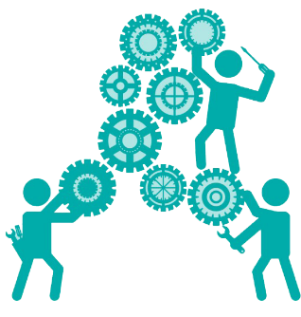
SOCIAL ORGANIZATION, MOVEMENTS, AND ACTIVISM
Digitally influenced social movements have the best opportunity for sustained success when they operate on both the local and global levels (this is called glocalization).
When multiple networks become activated at the local community level and the message is spread as widely as possible (often with photo and video accompaniment), social movements have the best chance to attain enough legitimacy and authority to have global reach.
Image Source: Freepik

Slide 20
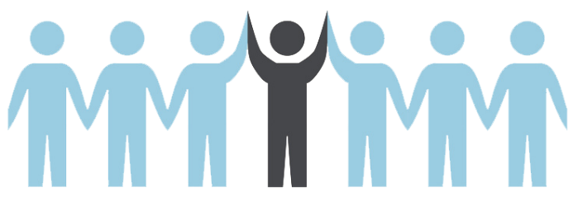
SOCIAL ORGANIZATION, MOVEMENTS, AND ACTIVISM
Image Source: EREMedia
While many digital movements pride themselves on being leaderless and decentralized, strong leadership is of great advantage in sustaining change over the long term.

Slide 21
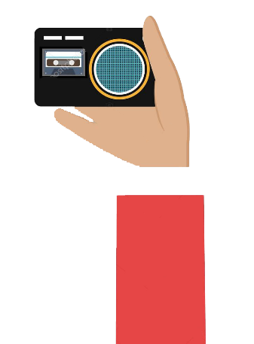
THE RISE OF CITIZEN JOURNALISM
Many people now choose to make their imprint on the world by using social media and blogs to spread and comment on the news and to take on tasks previously performed by professional journalists.
Citizen journalism can provide a voice for people in societies in which the mass media are not independent of the state or where freedom of the press is limited. In such areas, citizens have special motivation to use social media to share and stay abreast of the news. In China, for example, where the media are state controlled, mobile telephony is the least regulated media space.
Texting and social media provide opportunities for citizens to inform and be informed about current events and thus can potentially aid the spread of democracy and freedom. But at the same time, the problems and dangers that digital tech can enable, like surveillance and the spread of disinformation, can erode democracy and freedom.
We must be knowledgeable and aware of how we, and those around us, are using these technologies, and toward what end.
Image Source: Depositphotos

Slide 22


THE INTERNET, DIGITAL MEDIA & TECHNO-SOCIAL LIFE, 3RD EDITION
MARY CHAYKO
These lecture slides support the Sage Publications book Superconnected: The Internet, Digital Media, and Techno-Social Life (third edition, 2021) by Mary Chayko (Rutgers University) and were created by Mary Chayko, Shravan Regret Iyer and Seulki Lee-Geiller.
Text is excerpted from, and sources are referenced in, the book. Permission to use and share this slideshow is granted; please acknowledge Mary Chayko as author. For permissions and options for customizing these slides, contact Prof. Chayko at mary.chayko@rutgers.edu.
Review copies of Superconnected and copies for purchase may be obtained here

