Slide 1

third edition
THE INTERNET, DIGITAL MEDIA &
TECHNO-SOCIAL LIFE
MARY CHAYKO
8. THE TECHNO-SOCIAL INSTITUTIONS

Slide 2
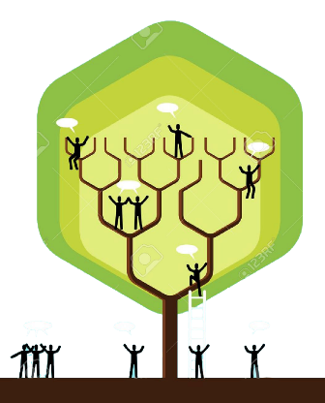

SOCIAL INSTITUTIONS
Social institutions are large systems that provide a society with structure and order and give its members a framework within which to build their organizations, connections and communities.
They are critical to helping a society (and its members) function, and social institutions (usually, the same ones described in this chapter) are found in all societies.
Image Source: 123RF

Slide 3
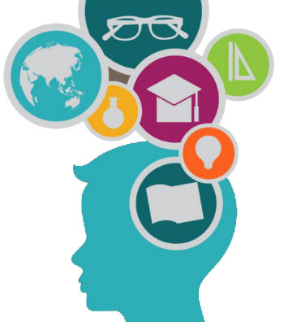
HOW TO STUDY AND UNDERSTAND THE SOCIAL INSTITUTIONS
It makes little sense to study social institutions in isolation from one another.
To understand how our families operate, for example, we must understand how their members work, are educated, practice their religions and politics, and so on.
We must consider the effects of a society’s systems of criminal justice, health care, media, and government on its members, and we must consider the effects of the activities in each social institution on one another.
As the famed sociologist Emile Durkheim (who actually coined the term “sociology” has said, the study of all of these systems, all the social institutions, makes the most sense as a concerted whole.
Image Source: Freepik

Slide 4
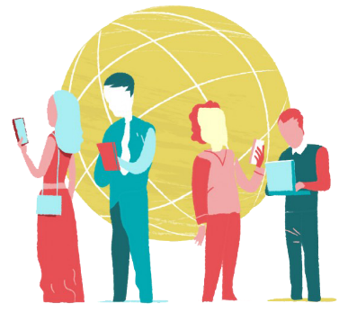
THE INSTITUTIONAL “HEART”: THE FAMILY
At the center of the social institutions lies the family: the heart of a society, the heart of life.
In tech-rich societies, families often use digital tech and social media to stay connected and in contact with one another.
To enable this, many such families invest in multiple ICTs that can be found in nearly every room of the house, and supply their members with multiple digital devices.
Image Source: Freepik

Slide 5
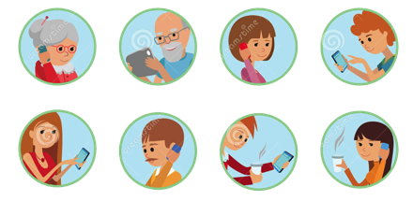
THE INSTITUTIONAL “HEART”: THE FAMILY
There are many challenges for families as they attempt to integrate technology into family life.
Parents and caregivers worry that children are online too much and they worry about what they are doing—including the digital footprint that may remain. They also worry about how their children treat one another online and whether they are contacting strangers online or face-to-face.
Many attempt to implement strategies aimed at controlling or reducing digital technology use, but these efforts are to some extent limited by the portability of mobile media and the freedoms this gives its users. It has become difficult, at any age to be fully integrated into society without using digital devices.
Image Source: Dreamstime

Slide 6
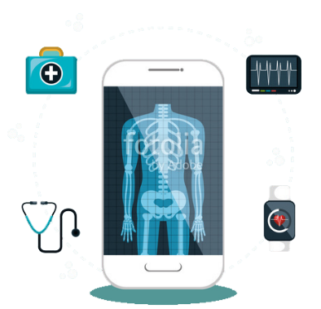
HEALTH CARE
The internet and digital media have come to have a profound influence on people’s health care and therefore their health, both physical and mental.
The storage, management, and transmission of health-related data now increasingly occur digitally. Technology also supports and influences clinical decision making and facilitates patient care, often from a distance.
While it is clear that health care practices are changing in high-tech digital societies, the impact of these e-health or telehealth changes is not yet clear.
Image Source: Fotolia.com

Slide 7
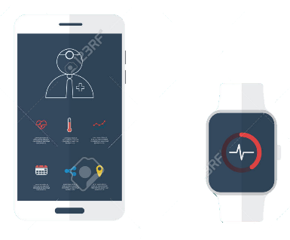
HEALTH CARE
Most people now look for health information online in addition to turning to their physicians, friends, and family.
What has been called “peer-to-peer” health care is flourishing—reminiscent of the ways that people helped one another in tribal communities that did not have access to modern medicine.
In general, both online and offline, the larger one’s network, the greater the health benefits. Online, people help one another find information, goods, and services that can improve their health, both physical and mental.
There are over 50,000 health-related apps, for diet, exercise, stress management, smoking cessation and dealing with chronic conditions.
Image Source: 123rf.com

Slide 8
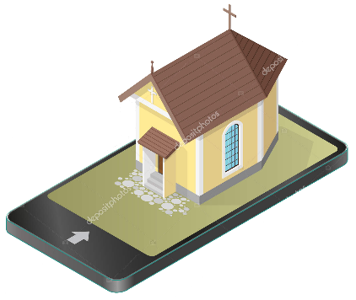
RELIGION
For many in technologically developed societies, the practice of religion has been transformed by the ubiquity of the internet and social media in their lives.
Now, many religious services take place online and can be attended from a distance. Cyberchurches have evolved from web forums to fully interactive sites in which members can view and engage in a service online or even take part in one as an avatar in the virtual reality “world” Second Life.
Image Source: Depositphotos

Slide 9
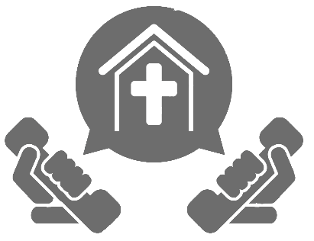
RELIGION
Media use not only increases people’s access to religion but can also supplement their understanding of it.
Websites, forums, and social media permit people to share, discuss, and debate religious issues. Spirituality in general has received a boost from the number of sites devoted to spiritual issues.
The openness of the internet is a problem for those who wish to utilize these applications but keep their worship private, however.
Image Source: Depositphotos

Slide 10
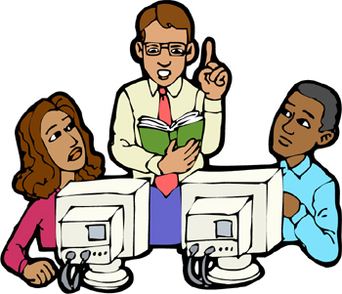
WORK AND COMMERCE
Work has undergone a massive transformation in the digital age, as the internet and digital media have become a critical part of organizing and transacting all kinds of business.
Computers and mobile media are used in countless organizational settings in a number of ways, from gathering data to organizing it to providing shared spaces for work.
In many companies and organizations, work is done and business is transacted in a number of spatially distributed settings, all coordinated via computer. This may be contributing to the popularization and spread of more collaborative, less hierarchical work practices.
Image Source: hcpl.net

Slide 11

WORK AND COMMERCE
Virtual organizations—sometimes called distributed work groups, virtual teams, or knowledge networks—are now prevalent.
These online work groups and their mobile equivalents can be quite successful in helping spatially separated people accomplish tasks together. People can work on multiple projects with multiple teams online.
Digital technologies like Skype and social media enable people to work and network together efficiently and effectively. The introduction of such technologies has provided sizable gains in productivity for many businesses.
Image Source: free-illustrations.gatag.ney

Slide 12

WORK AND COMMERCE
ATM machines have displaced some bank tellers, bloggers have pushed out some journalists, online travel sites have supplanted some travel agents, and robots, already being used in manufacturing, may someday replace some kinds of personal assistants and even caregivers.
Because some jobs can be done anywhere once digitized, they can be outsourced to other areas, including other countries, where they may be done for lower wages.
Image Source: Freepik

Slide 13

EDUCATION AND LIBRARIES
Computers and digital technology are now found in classrooms at all levels and libraries the world over.
Informational materials, lessons, and whole curricula can be delivered in online e-learning (or distance learning) environments, and this has become a popular option for the delivery of educational materials. During the global covid-19 pandemic, this kind of delivery became necessary.
Additionally, “hybrid” or “blended” educational settings, which are partly online and partly face-to-face, are becoming more prevalent and popular.
Image Source: Dreamstime.com

Slide 14
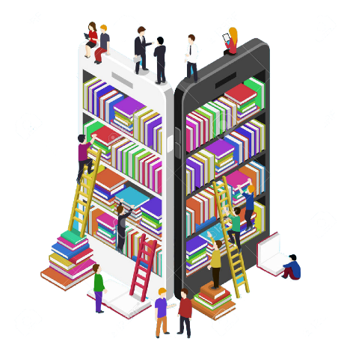
EDUCATION AND LIBRARIES
In many ways, schools, schooling, libraries and institutions of higher education no longer resemble their counterparts of the early 2000s—or even the 2010s.
But while digital technology has certainly had a tremendous effect, print books remain central to reading and learning experiences. More Americans than ever are reading, including e-books and print books.
Still, reading books and other material online, on e-readers, and on the go has become a primary way to access information, especially up-to-date information.
Teachers and librarians must grapple with and adapt to these new realities.
Image Source: 123RF

Slide 15
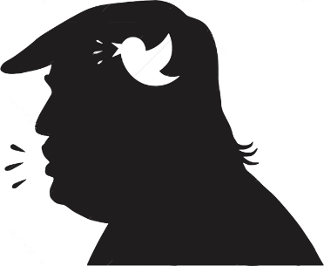
POLITICS AND GOVERNING
Digital technologies are having a strong influence in, and are indeed revolutionizing, politics. Modern political campaigns have been transformed by internet and digital technologies, particularly social media.
The use of social media (especially Twitter) by Donald Trump is perhaps the most dramatic example of the power of social media in politics.
Trump used Twitter as a platform to speak directly to voters and citizens, sidestepping traditional media outlets and disrupting traditional practices of dealing with the press.
Image Source: VectorStock

Slide 16
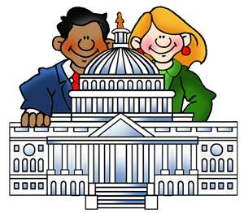
POLITICS AND GOVERNING
Properly implemented, digital technologies could also revolutionizing governing. They could assist in the coordination of government agencies, increase efficiency, and help boost economic growth. In a time of fiscal pressures and burdens and, often, political unrest, this is greatly needed.
Comprehensive rethinking and redesign of governmental communication and information infrastructures—an e-government—is increasingly possible. The digital infrastructure of a nation can be rebuilt from the ground up, coordinating critical systems like citizen identification, record-keeping, taxing, social services, and health care.
Unfortunately, most governments still often operate in inefficient ways and do not make the best use of the digital tools and strategies available to them. Thus, few governments have been able to benefit fully from digitization.
Image Source: effectivepractices.wikispace.com

Slide 17

THE MEDIA
In recent years, the internet and digital media have begun to be included in the mass media when the role of the media as a social institution is invoked.
As we have seen, the internet, digital technology, and social media have had an impact on the world that is nothing less than revolutionary.
Image Source: FreeDesignFile

Slide 18
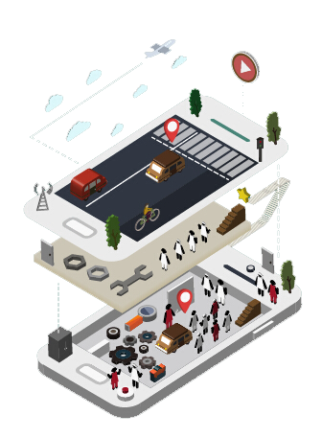
THE MEDIA
While the government exerts substantial control over the mass and digital media in many countries worldwide, in democratic societies the media is considered separate from the institution of governing.
It is organized as a market, not a state, system and is expected to be controlled and staffed by professionals who seek to be accurate, impartial, and informative.
But increasingly, the mass media (and by association, digital media) are consolidated in the hands of fewer and fewer organizations and individuals – a trend which has serious implications for the communication of a diversity of viewpoints, the truth and fairness of the information shared, and democracy itself.
Image Source: FreeDesignFile

Slide 19
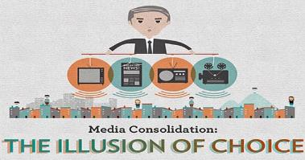
THE MEDIA
A handful of corporations in the United States—at this writing, Comcast, Disney, Viacom/CBS, and AT&T (via Warner Media)—act as conglomerates, controlling 90% of what is read, watched, or listened to via the media.
They own TV and radio stations, newspapers, magazines, movie studios, even sports stadiums and theme parks.
This means that only a couple of hundred executives play an outsized role in determining much of what we are exposed to via the media.
In other countries, the media is similarly concentrated in a handful of corporations or, in some cases, political parties.
Image Source: truth-code.com

Slide 20
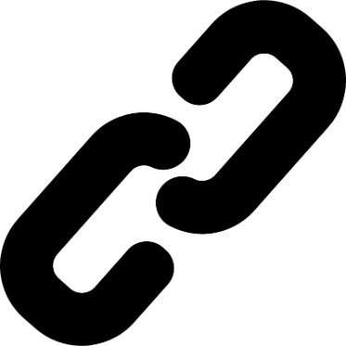
THE MEDIA
The structure of online internet-based journalism and news is also changing.
While content can be reproduced on the internet in much the same way as it exists in print form, it can also contain hyperlinks that enable readers to access additional information.
Online news stories can also contain original content designed specifically for the internet, include multimedia content, and permit readers to contribute by posting their own opinions, commentary, or even links to related information sources.
Image Source: FreeVector.co

Slide 21
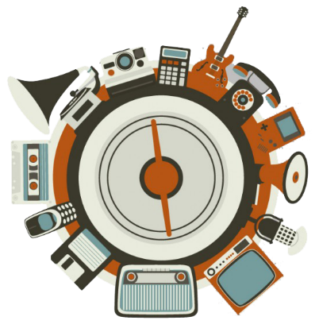
THE MEDIA
The internet and digital media have also made possible what can be called a convergence culture.
As multiple media industries present different versions or aspects of stories, audiences can migrate from place to place as they follow or participate in a media offering.
A single cultural franchise, such as Batman, Star Wars, the Matrix movies, or Harry Potter, can now be distributed through a range of media delivery methods. Audiences can actively search the form of entertainment experience they want. More stories can now be told, over more platforms, reaching more people.
The pop culture industry and experience of participation and enjoyment has been transformed by this trend.
We are clearly seeing pronounced shifts in our techno-social institutions. It is important to keep in mind that they do not exist independently of the agency of social members who create them with our individual and collective actions. If you don’t like it, work to change it!
Image Source: Freepik

Slide 22


THE INTERNET, DIGITAL MEDIA & TECHNO-SOCIAL LIFE, 3RD EDITION
MARY CHAYKO
These lecture slides support the Sage Publications book Superconnected: The Internet, Digital Media, and Techno-Social Life (third edition, 2021) by Mary Chayko (Rutgers University) and were created by Mary Chayko, Shravan Regret Iyer and Seulki Lee-Geiller.
Text is excerpted from, and sources are referenced in, the book. Permission to use and share this slideshow is granted; please acknowledge Mary Chayko as author. For permissions and options for customizing these slides, contact Prof. Chayko at mary.chayko@rutgers.edu.
Review copies of Superconnected and copies for purchase may be obtained here

