Slide 1

third edition
THE INTERNET, DIGITAL MEDIA &
TECHNO-SOCIAL LIFE
MARY CHAYKO
9. More Benefits and Hazards of 24/7
Superconnectedness

Slide 2
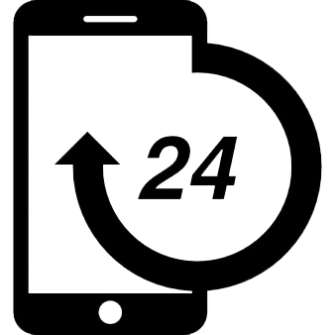

CONSTANT AVAILABILITY
Constant availability and continuous connectedness provide digital tech users with an ambient awareness of one another that is remarkably persistent and a host of obligations and responsibilities.
It is also implicated in many of the troubling by-products of techno-social life such as vertical and horizontal surveillance, lack of privacy, data mining, cybercrime and cyber-terrorism.
But for better or worse, an always-on, always-connected, 24/7 culture has arrived and is in full swing, and has become a hallmark of modern techno-social life.
Image Source: Freepik

Slide 3
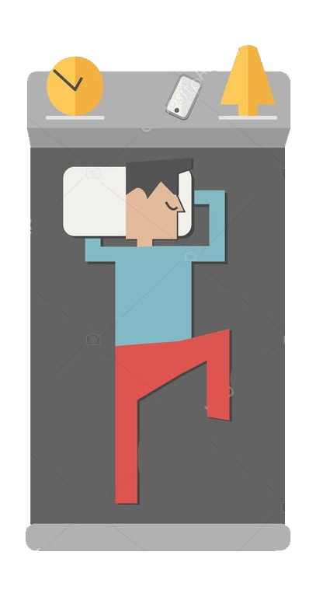
CONSTANT AVAILABILITY
Many cell phone users even sleep with their phone under their pillow or on their bedside table, providing the feeling that they are constantly connected to the world and therefore less alone.
But they can also become so used to the ease and convenience of connecting digitally that they feel anxious, lost, and unmoored when disconnected.
Image Source: Depositphotos

Slide 4
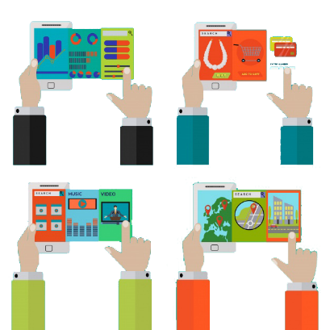
CONVENIENCE AND MICROCOORDINATION
Digital technologies, especially mobile phones, have become critical to the coordination of day-to-day activities.
They have even changed the ways that we plan and enjoy activities.
Individuals now frequently make or reconfigure plans last minute or while in transit (this is called microcoordination); they do not plan ahead in the way that was required before cell phones.
Image Source: Freepik

Slide 5
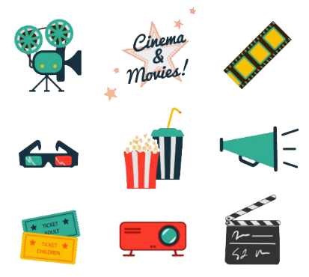
FUN, PLAY, AND ENTERTAINMENT
It can be tempting for those who are digitally connected to fill moments that might otherwise be quiet or dull with a constant stream of entertainment in addition to information and interaction.
With great frequency, people go online to enjoy themselves, play games, engage in cultural activities, or otherwise be entertained or have fun.
Sometimes, they just “hang out” in digital spaces.
For many, boredom may be becoming more and more difficult to tolerate.
Image Source: Freepik

Slide 6
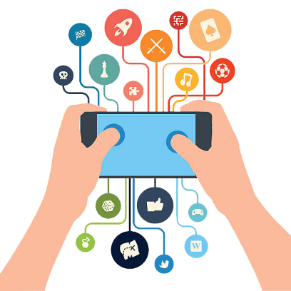
FUN, PLAY, AND ENTERTAINMENT
Gaming is another very popular online activity. Whether they are individualized, small group, or involve massive numbers of people, games can be intensely involving and can stretch over long periods of time, even years. They create environments that players insert themselves into, inhabit, and can become deeply immersed in.
Highly social, video games are populated on and “behind” the screen with others that a player gets to know. Some games are even enabled with the technology of virtual reality, an immersive, computer-generated, multimedia environment that replicates physical experience in a highly realistic way.
Image Source: iStock

Slide 7
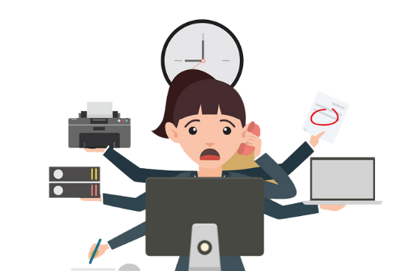
MULTITASKING AND THE ATTENTION SPAN
Because people can use the internet and digital media to move fluidily from place to place and from screen to screen, they can find that directing their attention to any one topic and having it remain there is a challenge.
They may feel easily distracted, their minds jumping from thing to thing. It may be becoming difficult for individuals to focus on one specific thing for an extended time, challenging the modern attention span.
Image Source: Freepik

Slide 8
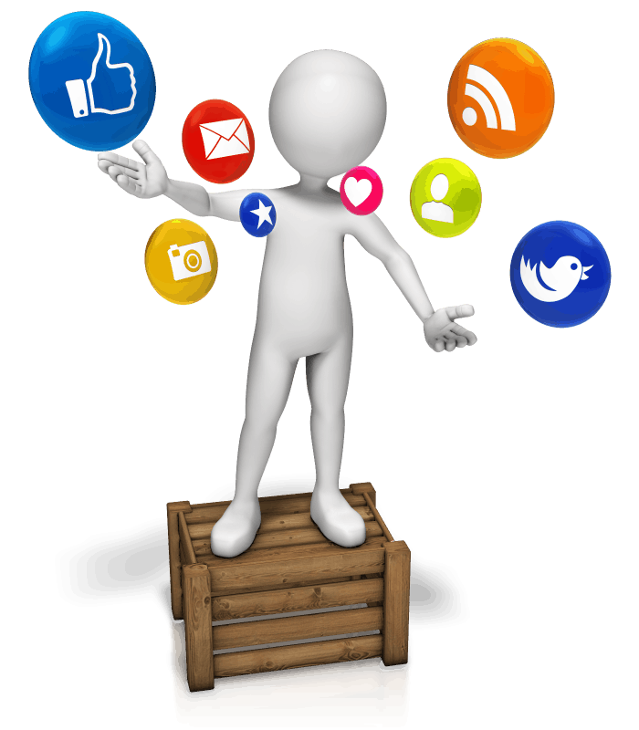
MULTITASKING AND THE ATTENTION SPAN
Multitasking is a somewhat misleading term. It is not really possible to do several complex cognitive tasks simultaneously. More often, people move back and forth from task to task, switching as rapidly as they can or need to.
Some people are better than others at doing this and can maintain focus on different tasks fairly well without their concentration suffering substantially, while others are not able to do so.
Most of us can not and suffer greatly when we try too hard and too often to multitask. In general, people who attempt to multitask regularly and chronically suffer cognitive and behavioral deficits. They have difficulty recalling information and are slower at processing information
Image Source: c-marketing.edu

Slide 9
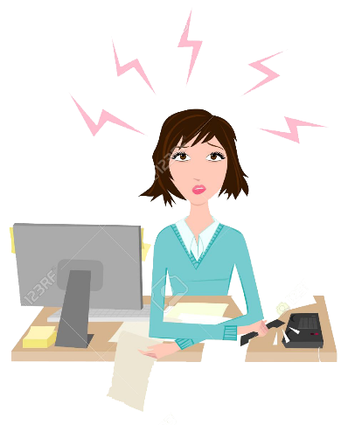
STRESS, INFORMATION OVERLOAD, AND FOMO
Keeping up with a flood of stimuli and information can be challenging and burdensome.
Tasks may start to snowball; people can feel that they need to work and/or be digitally connected day and night, lest they fall behind the curve.
But using social media to keep track of how family and friends are doing and to feel closer to them can also relieve stress.
Image Source: Okclipart.com

Slide 10
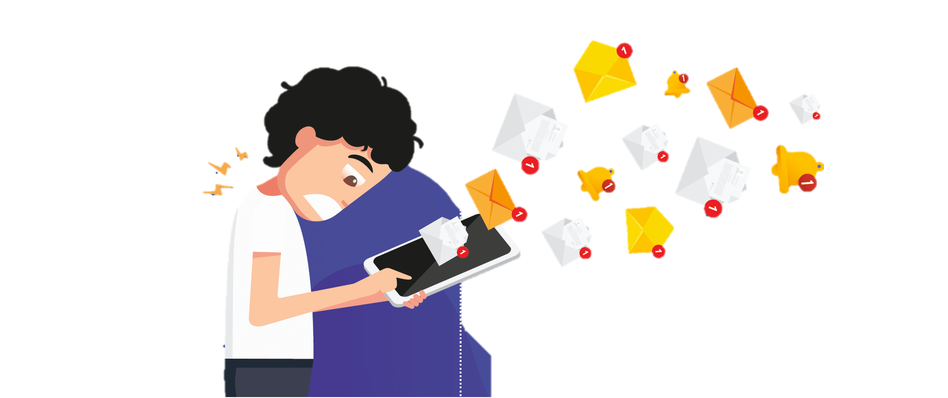
STRESS, INFORMATION OVERLOAD, AND FOMO
There is much talk about FOMO, which is the “fear of missing out”. However, some social media users do not find FOMO particularly stressful. As always, it’s how one uses the technology that causes an outcome.
Also, information overload, having too much information at our fingertips, as well as too many choices available in general can be overwhelming.
Image Source: CleverTap

Slide 11
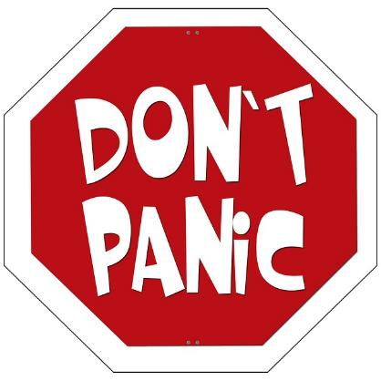
EMERGENCIES
With mobile phones at the ready, people can now take care of one another and reach out to one another more easily in emergencies.
Many people report needing or wanting to have a cell phone nearby at all times because they feel safer and more comfortable in the event that an emergency might occur.
Image Source: pixabay.com

Slide 12
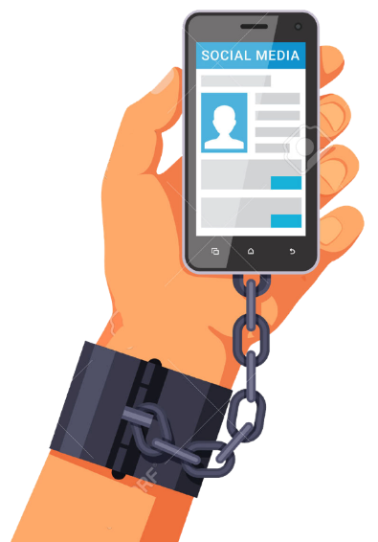
DEPENDENCY AND ADDICTION
There is real concern over whether too-frequent use of the internet, digital media, and mobile devices like cell phones can create a dependency on or addiction to these technologies.
Such problems include
the individual’s loss of control over internet use
psychological, social, or professional difficulties
preoccupation and cravings when not using the internet.
Image Source: 123RF

Slide 13
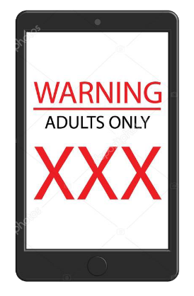
DEPENDENCY AND ADDICTION
Some scholars, however, claim that the addiction model is not quite appropriate when chemical or physiological disease is absent.
To be sure, people can become deeply and troublingly immersed in behaviors like gambling, pornography use, compulsive online shopping and consumerism, the pursuit of unhealthy relationships, and so on.
These problems all exist outside of internet and digital media use as well, however.
They were problems before the advent of the internet and would be considered problems in any context.
Image Source: Depositphotos

Slide 14
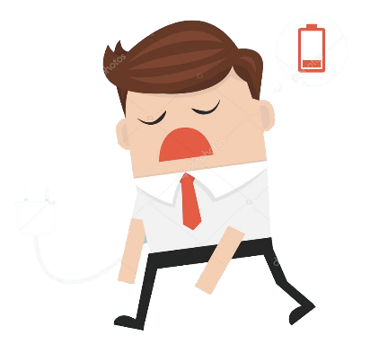
HEALTH, INCLUDING MENTAL HEALTH, AND MOODS
Research indicates that too much time spent in front of computer and mobile screens is associated with low energy and fatigue.
An increase in hours spent shopping, playing games, and doing research on the internet is associated with increased depressive symptoms.
Image Source: fr.depositphotos.com

Slide 15
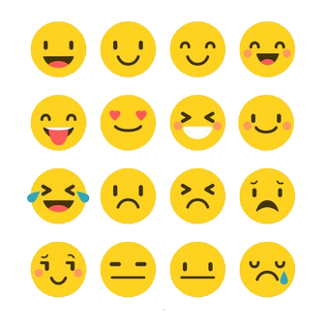
HEALTH, INCLUDING MEANTAL HEALTH, AND MOODS
But moods can also be enhanced as a consequence of using the internet and digital media. When people spend time in meaningful conversation and in communities online, their moods and well-being tend to improve.
Image Source: Freepik

Slide 16
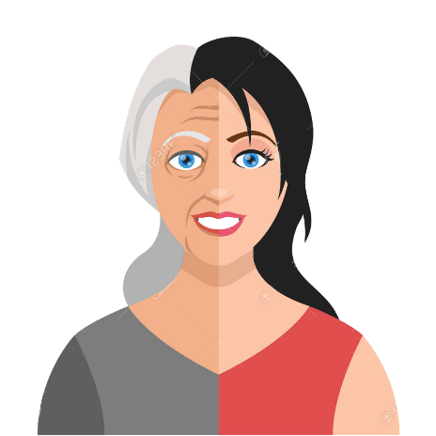
HEALTH, INCLUDING MEANTAL HEALTH, AND MOODS
Using social media can also help delay the effects of aging and improve the physical and mental well-being of elderly people.
And playing games online has been found to help fight the effects of aging in the areas of reaction time, attention span, and visual recognition.
Image Source: 123RF

Slide 17
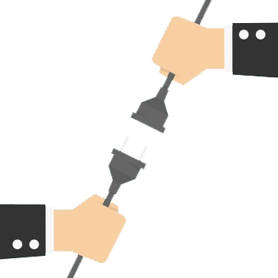
BEING PLUGGED IN . . . TO SOCIETY
Even the most solitary among us need to feel “plugged in” to the world around us—plugged in to society.
Humans are social animals and cannot develop mentally, emotionally, or physically if they do not have regular sources of interaction and a sense of connection to and understanding of the world around them.
Image Source: Freepik

Slide 18
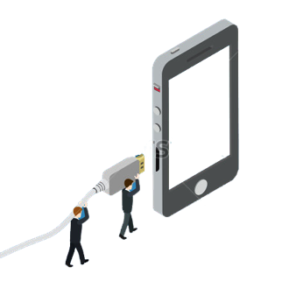
BEING PLUGGED IN . . . TO SOCIETY
Just as surely as cords and chargers plug our devices into electric outlets, technology plugs us into society. It connects us, again and again, to pathways, networks, and communities.
At least some subset of one’s network of friends, family, and acquaintances is nearly always reachable and can provide us with information, continuity, and community. Literally and figuratively, members of tech-rich societies are more plugged in to the world around them than ever before.
Image Source: Shutterstock

Slide 19


THE INTERNET, DIGITAL MEDIA & TECHNO-SOCIAL LIFE, 3RD EDITION
MARY CHAYKO
These lecture slides support the Sage Publications book Superconnected: The Internet, Digital Media, and Techno-Social Life (third edition, 2021) by Mary Chayko (Rutgers University) and were created by Mary Chayko, Shravan Regret Iyer and Seulki Lee-Geiller.
Text is excerpted from, and sources are referenced in, the book. Permission to use and share this slideshow is granted; please acknowledge Mary Chayko as author. For permissions and options for customizing these slides, contact Prof. Chayko at mary.chayko@rutgers.edu.
Review copies of Superconnected and copies for purchase may be obtained here

